Slide 1
Introduction to the CH552G Microcontroller
Presented by Richard Gowen (@alt_bier)
Created for BSidesDFW 2020 HHV
This Slide Deck Is Available at https://altbier.us/ch552g/

Slide 2
What is a Microcontroller?
A microcontroller is a compact integrated circuit (IC) designed to govern a specific operation in an embedded system. A typical microcontroller includes a processor, memory and input/output (I/O) peripherals on a single chip.
If you seriously did not know what a microcontroller was before ending up here this may not be the presentation for you.
This presentation will focus on the technical details of a specific microcontroller, the CH552G, and how to work with it.

Slide 3
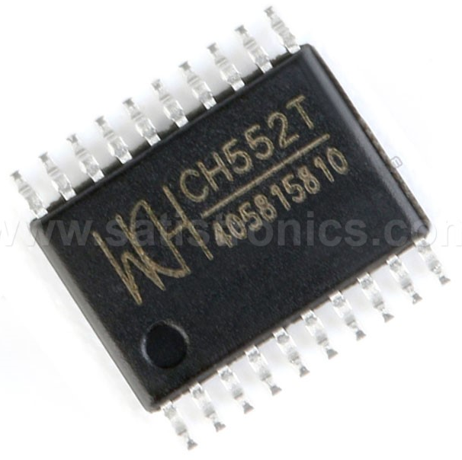
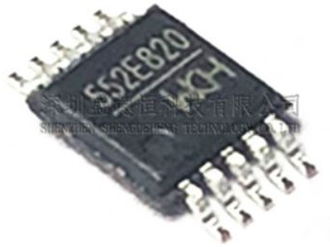
CH552 Overview
The CH552 series of 8-bit USB device microcontrollers are MCS51 compatible with an E8051 core processor.
CH552 supports up to 24MHz system clock speed, built-in 16K ROM, 256 bytes iRAM and 1K xRAM with DMA support.
Features include built-in bootloader, built-in USB controller with device mode, PWM, full duplex UART, and a SPI communication interface
Manufactured by Nanjing Qinheng Microelectronics WCH http://www.wch.cn/
Available in several different form factors:
TSSOP-20 (CH552T)
SOP-16 (CH552G)
MSOP-10 (CH552E)

Slide 4
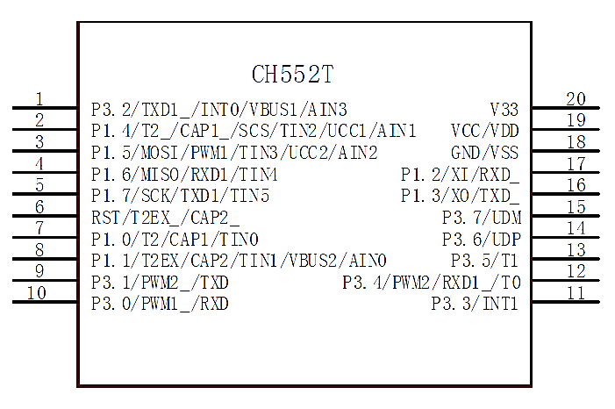
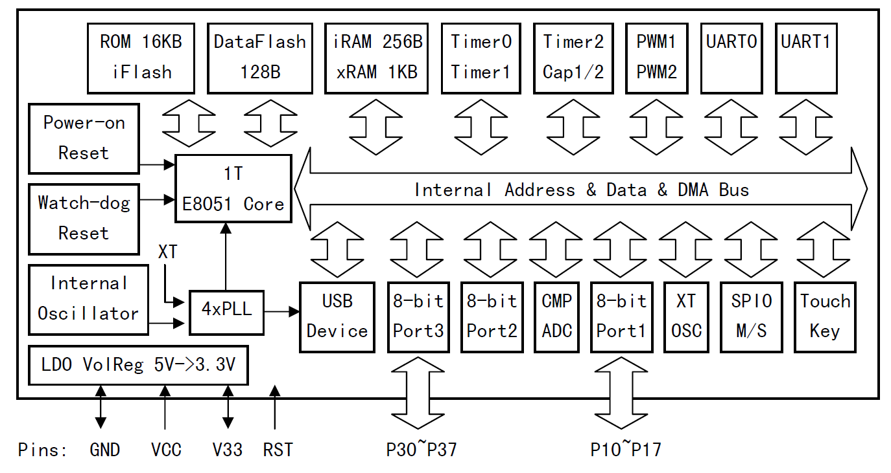
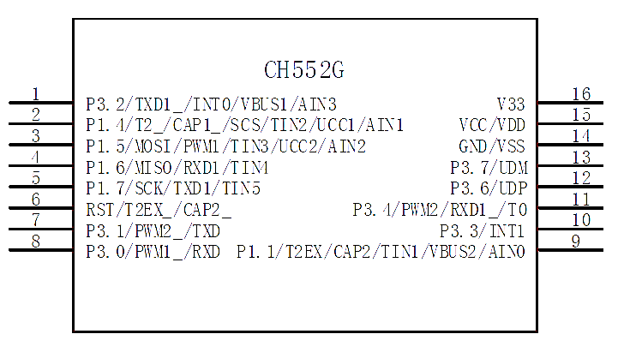
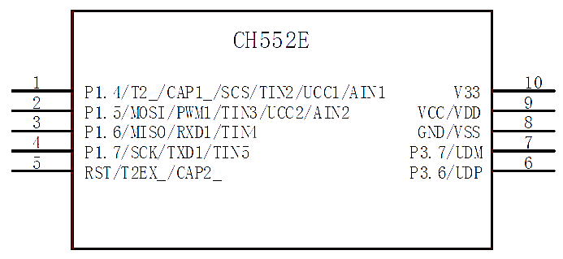
CH552 Architecture
Regardless of form factor the CH552 series microcontrollers share a common architecture. The form factor determines which external pins are available.

Slide 5
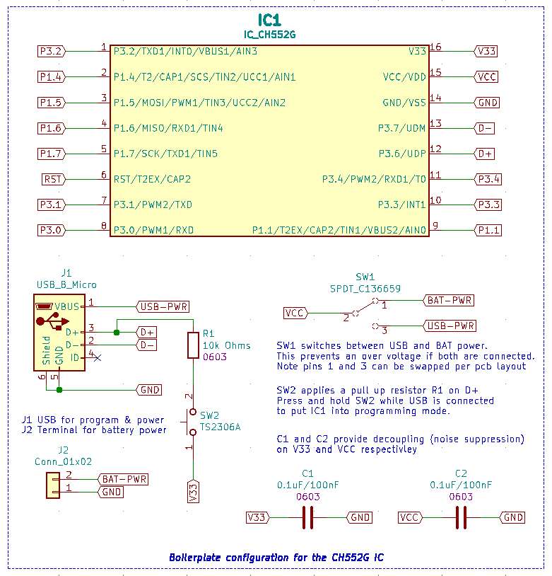
CH552G Pinout and Boilerplate Schematic
The CH552G pinout is detailed on my boilerplate schematic to the right.
This schematic was created in KiCad and is available via my recent badge project repos (detailed later)
To place the IC into programming mode (allowing new code to be uploaded via USB) a pull up voltage must be applied to pin 3.6 (USB D+).
Decoupling capacitors provide noise suppression on the power pins which is a requirement for the USB connector.

Slide 6
Programming the CH552G
The CH552G E8051 chipset can be programmed using:
Kiel C51 https://www.keil.com/c51/
SDCC (Small Device C Compiler) http://sdcc.sourceforge.net/
Since Keil has a cost associated with it, I personally use SDCC.
The best CH552 SDCC SDK I’ve found is from Blinkinlabs who ported the CH554 Kiel SDK to SDCC. This includes the C header files needed to work with the CH552 chips. It can be found here:
https://github.com/Blinkinlabs/ch554_sdcc/
Loading the firmware onto the chip can be done using the official WCH program WCHISPTool (Windows) http://www.wch.cn/ (service->downloads) or via multiple open source tools such as:
LibreCH551 https://github.com/rgwan/librech551
ch552tool https://github.com/MarsTechHAN/ch552tool

Slide 7
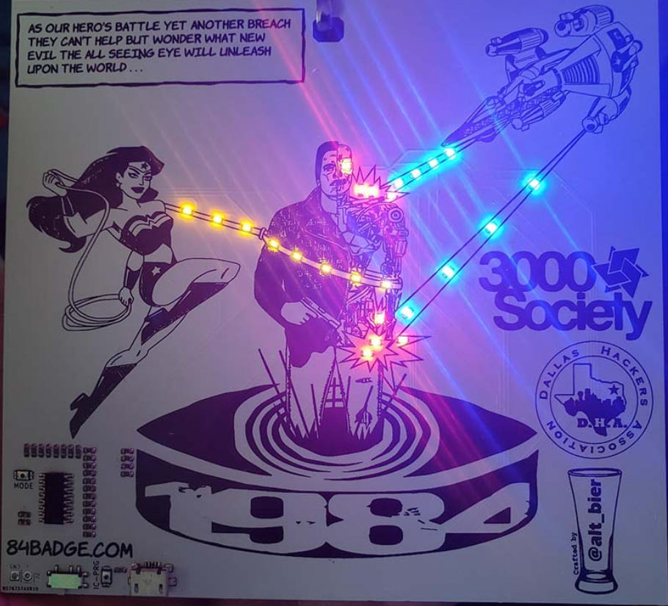
My CH552G Projects
I have used the CH552G in two of my badge projects (so far):
The Akira Badge (BSidesDFW 2019 badge)
https://akirabadge.com/
The 84 Badge (Defcon 28 Indie badge)
https://84badge.com/
PCB design incorporating the CH552G and code using it to drive the badge components are detailed on the project pages and associated repositories.

Slide 8
CH552G Projects by Others
What first got me interested in the CH55x ICs was a story I read about them on https://hackaday.com/ about the architecture and the work Blinkinlabs did porting the SDK.
What made me decide to try using it in a project of my own was another hackaday story named “How to program a really cheap microcontroller” https://hackaday.com/tag/ch552/ which detailed the project work of Aaron Christophel showing the power of this little chip.
The project that Aaron reviews in his video https://youtu.be/IDCQNa2ywiM used a CH552G to drive several components including an IPS display with an SPI bus.
I liked that he started by showing how he hacked his own interface PCB for the IC and progresses to drawing up a schematic and walking through his project code.

Slide 9
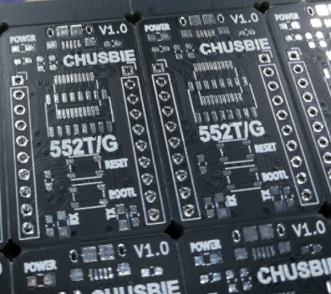
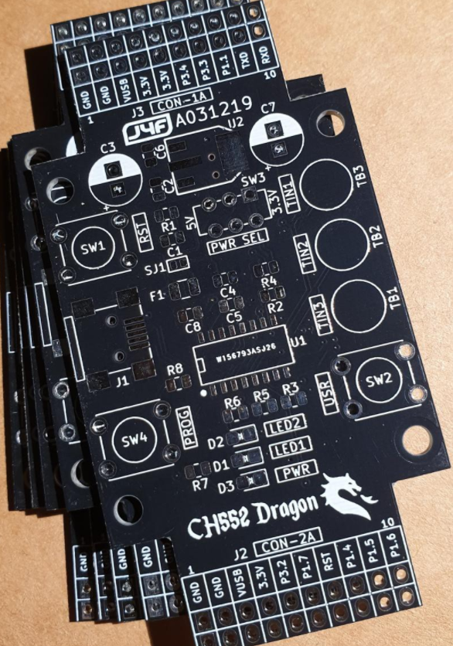
CH552G Projects by Others
Some other greats projects I found when doing research were some CH552 development boards
The first is called the CHUSBIE and works with CH552T & G.
You can find the CHUSBIE project details here:
https://hackaday.io/project/171543-chusbie552-ch552-development-board
The next one is called the CH552 Dragon for the CH552G.
You can find the CH552 Dragon project details here:
https://hackaday.io/project/169671-ch552-dragon

Slide 10
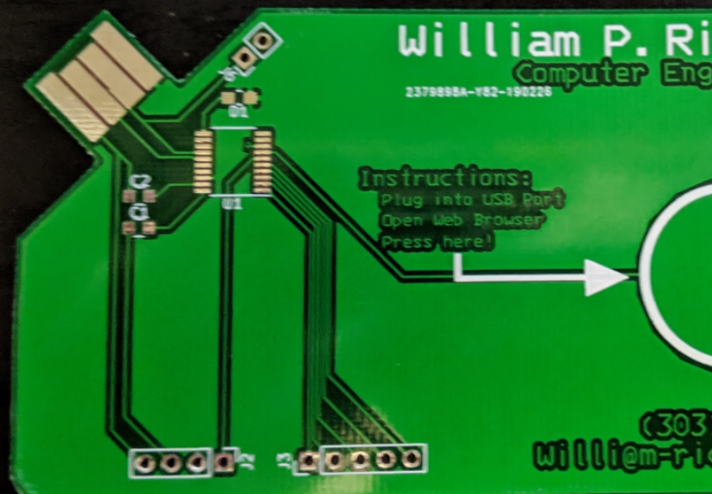
CH552G Projects by Others
Another great project I was pointed to by the #badgelife community was by @wrickert7
He had created an electronic business card project using the CH552T including a development board for the project.
I found his documentation and firmware to be very helpful in my understanding and usage of the CH552 chips.
You can find the wrickert/CH552 project details here:
https://github.com/wrickert/CH552

Slide 11
Thank You
I hope you enjoyed this presentation and learned something from it.
-- @alt_bier
This Slide Deck – https://altbier.us/ch552g/
Code – https://github.com/gowenrw/BSidesDFW_2020_HHV/

