Slide 1
Learn CircuitPython using the Adafruit Trinket M0
Presented by Richard Gowen (@alt_bier)
Created for BSidesDFW 2020 HHV
This Slide Deck Is Available at https://altbier.us/circuitpython/

Slide 2
What is CircuitPython?
CircuitPython is a programming language designed to simplify experimenting and learning to code on low-cost microcontroller boards.
CircuitPython is based on the Python programming language.
Python is a widely used high level language that is easier to read, write and maintain than low level languages like C. It supports modules and packages, has a built-in interpreter (which means no compiling), and is open source.
CircuitPython adds hardware support to all these great features.
If you already have Python knowledge, you can easily apply that to using CircuitPython. If you don’t, it's simple to get started!

Slide 3
What is the Adafruit Trinket M0?
The Adafruit Trinket M0 is a tiny microcontroller board that has been designed to work with CircuitPython.
The Trinket is a hardware development board like an Arduino and can even run Arduino code.
It comes shipped with CicuitPython firmware installed. So when you plug it in it will show up as a very small disk drive with some files including main.py on it.
Simply edit main.py with python code. No IDE required.
Specs:
Processor: Atmel ATSAMD21E18 32-bit 48MHz Cortex M0+
Flash: 256 KB
RAM: 32 KB
Native USB Support
Support for both Arduino IDE and CircuitPython
5 GPIO Pins
Analog input on 3 pins and true analog output on 1pin
PWM output on 3 pins
Capacitive touch sensors on 3 pins

Slide 4
Adafruit and CircuitPython Resources
The Adafruit website https://www.adafruit.com/ is where you will find the documentation and other resources for their products.
You can purchase a Trinket M0 here: https://www.adafruit.com/product/3500
Trinket M0 Documentation: https://learn.adafruit.com/adafruit-trinket-m0-circuitpython-arduino/
The CircuitPython website https://circuitpython.org/ is a great resource for documentation and software and example code.

Slide 5
Electronics 101
Working with hardware development boards such as the Adafruit Trinket M0 is easier if you have a basic knowledge of electronics concepts.
This presentation will not provide that knowledge. However, I have put together a separate presentation that does.
You can find my electronics overview presentation here: https://altbier.us/electronics/

Slide 6
Mu Editor Software
While an Integrated Development Environment is not required to work with CircuitPython (any editor will work), Mu is a simple code editor that works with the Adafruit CircuitPython boards. It has a built-in serial console, so you can get immediate feedback from your board's serial output.
You can download it from https://codewith.mu/ It is available for the Windows, Linux, MacOS, and Raspberry Pi operating systems.

Slide 7
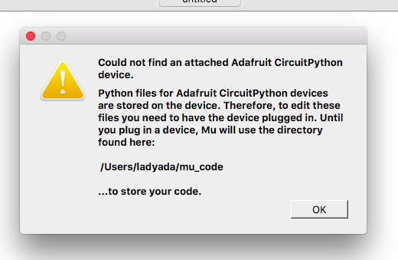
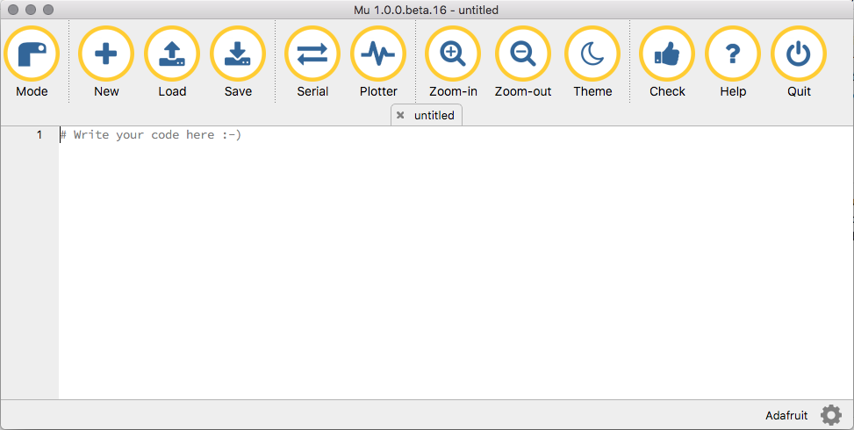
Mu Editor Software
The first time you start Mu, you will be prompted to select your 'mode' - you can change this later. If you are going to use Mu for the Labs presented here, you should select ‘Adafruit CircuitPython’.
Mu attempts to auto-detect your board, so plug in your Trinket M0 device via USB and make sure it shows up as a drive named CIRCUITPY before starting Mu.
Once your device is plugged in and Mu is started you are ready to write some code!

Slide 8
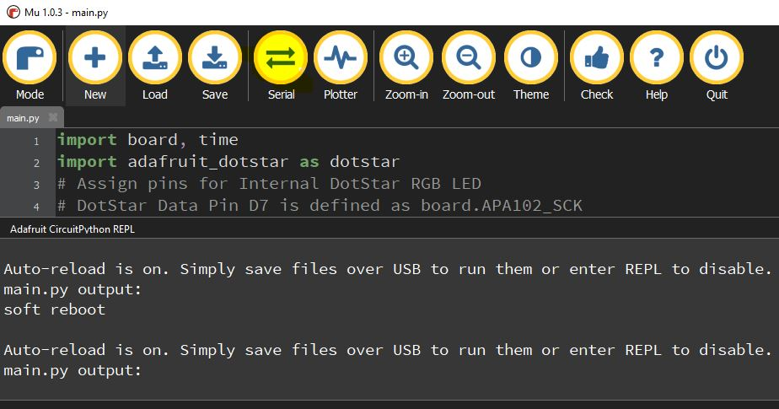
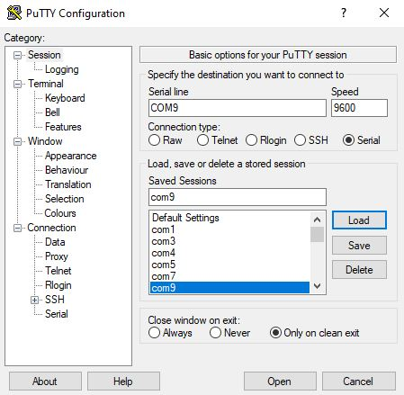
Serial Monitor
To view the serial output of the Trinket M0 or any CircuitPython device you’ll need a serial monitor.
In the Mu editor program there is a serial monitor built in that can be launched by clicking the ‘Serial’ button.
If you’re not using that software, there are other ways to monitor the serial output.
Look up the COM port number that your PC assigned to the Trinket when you connected it.
Use a terminal program that supports serial connections (like PuTTY) and configure it to connect to the COM port at 9600 baud.

Slide 9
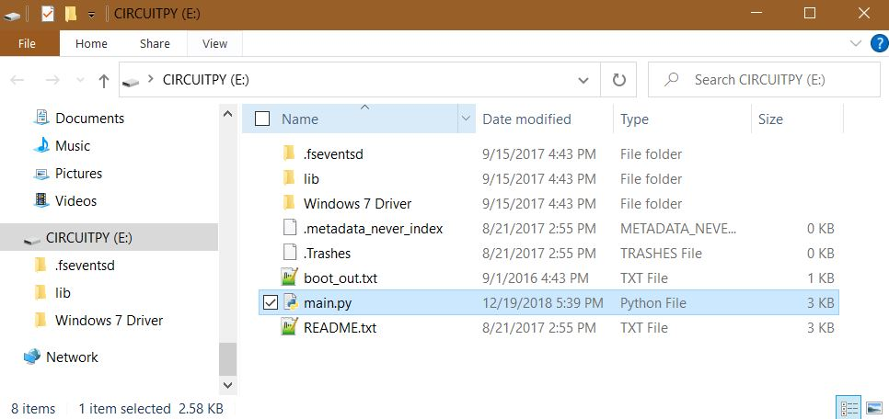
Connecting the Trinket M0
When you connect the Trinket M0 to your machine via USB is should open a small drive named CIRCUITPY.
This drive is where you will place your code and libraries.
It comes installed with a main.py file and some basic library files in a lib directory which are running demo code that will color cycle the on-board DotStar LED.

Slide 10
Verify the Trinket M0 Firmware Version
There are several versions of CircuitPython firmware available, and the library files are not compatible between major versions (e.g. 2.x, 3.x, 5.x, 6.x, etc.)
So, you should verify the version of CircuitPython firmware loaded on your Trinket M0 before you start working with it.
This is easily done by connecting it and opening a file named boot_out.txt in the root of the CIRCUITPY drive.
This file will contain a line of text that shows the CircuitPython version.
Note that my Trinket M0 came shipped with version 3.1.1 which I want to upgrade.

Slide 11
Upgrading the Trinket M0 Firmware
To update the firmware is a fairly simple process.
Download the firmware file from https://circuitpython.org/board/trinket_m0/
Click the ‘Download .UF2 Now’ button to download the latest stable firmware version.
Note: The latest stable version at the time of this writing is 5.3.1 which is what we will use in these Labs.
Connect the Trinket M0 which will open a USB drive called CIRCUITPY.
Optionally back up any .py files and the lib directory to your machine.
Click the Reset button on the trinket twice.
Not like a mouse Double-click, but more like Click-pause-Click.
You should see the DotStar LED turn green and a new disk drive appear called TRINKETBOOT.
Copy the .uf2 extension firmware file (e.g. adafruit-circuitpython-trinket_m0-en_US-5.3.1.uf2) to the TRINKETBOOT drive.
The Red LED will flash then the TRINKETBOOT drive will disappear and the CIRCUITPY drive will reappear.
The main.py file and library files in lib may be deleted in this process.
That’s it, the trinket is now running the new firmware for the Circuit Python version that you copied to it.

Slide 12
CircuitPython Library Files
Whether you recently upgraded or just want to create a new project with your current version of CircuitPython, you will want to download the library files for the version you are working with.
Given the small amount of storage available it is important to only add the libraries you need to your device.
You'll want the compiled library files available on your PC to allow you to keep file size down and copy only what you need when you need it.
The library file bundle package is also a good source of example code covering various tasks.

Slide 13
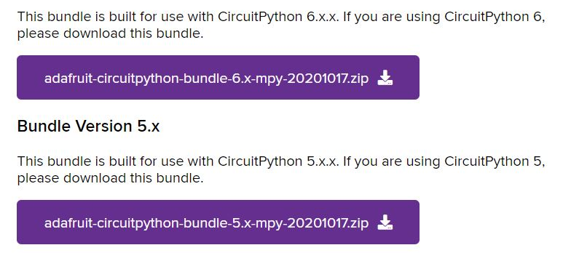
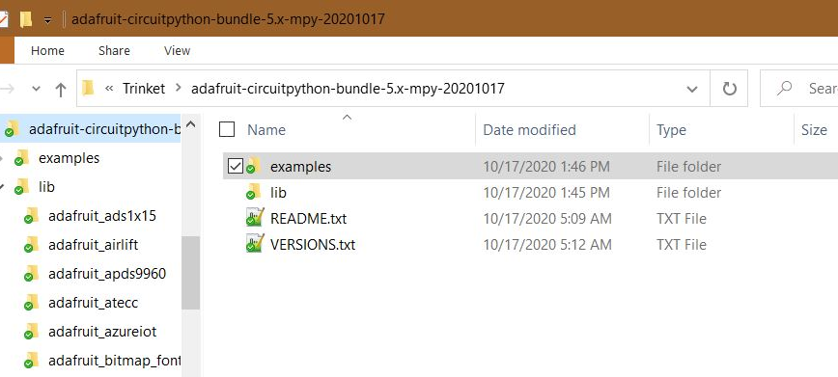
Downloading CircuitPython Library Files
You can find the library file bundle packages for recent versions of CircuitPython here: https://circuitpython.org/libraries
Choose the bundle that corresponds with your version and extract it.
Now just copy any file you need from the lib directory.

Slide 14
Testing Trinket After Firmware Upgrade
When you upgrade the CircuitPython firmware it may delete your python code and library files, or worse leave them in place and non-functional. So, its best to clear any files and load new ones to test.
There are a few empty files that should be left on the CIRCUITPY drive since they are there to prevent your PC from storing hidden files on the tiny drive. These are:
.metadata_never_index
.Trashes
.fseventsd
.fseventsd/no_log
The lib directory can remain but should be empty.

Slide 15
Testing Trinket After Firmware Upgrade
Create a file named main.py using Mu or your favorite editor.
In the main.py file add the code shown on the right.
This simple code will test that things are working.
This code should blink the small Red LED in the corner of the board and print some text to serial output.
It will also cause the RBG LED in the center of the board to light solid Green indicating that it is running a program without error.
If the Red LED is not blinking or the RBG LED is not solid Green, then there is a problem.
Check that your indentation is consistent in main.py (Python is strict about indentation)
import board
import digitalio
import time
# Assign pin D13 (On-Board Red LED)
rled = digitalio.DigitalInOut(board.D13)
# Set pin IO Direction
rled.direction = digitalio.Direction.OUTPUT
# Main Loop
while True:
# Serial Output
print("Hello, CircuitPython!")
# Set LED state to ON
rled.value = True
# Pause for 1 second
time.sleep(1)
# Set LED state to OFF
rled.value = False
# Pause for 1 second
time.sleep(1)

Slide 16
Troubleshooting Problems
The Trinket M0 and it’s CircuitPython firmware will attempt to help you troubleshoot problems.
The DotStar RGB LED will display a status color and flash an error code as shown on the right.
Error messages are sent via serial output. So a serial monitor will allow you to see detailed error messages that will help you correct the problem.
Note: The Mu editor has a built-in serial monitor that can interface with the Trinket M0 and display these messages.
The Trinket M0 uses the DotStar RGB LED on the board to indicate the status of CircuitPython.
Here is how to read it:
steady GREEN: main.py is running
pulsing GREEN: main.py has finished or does not exist
steady YELLOW at start up (4+) Waiting for a reset to indicate that it should start in safe mode
pulsing YELLOW: In safe mode – (crash & restart)
steady WHITE: REPL is running
steady BLUE: boot.py is running
Colors with multiple flashes following indicate a Python exception and then indicate the line number of the error. The color of the first flash indicates the type of error:
GREEN: IndentationError
CYAN: SyntaxError
WHITE: NameError
ORANGE: OSError
PURPLE: ValueError
YELLOW: other error
These are followed by flashes indicating the line number. WHITE flashes are thousands' place, BLUE are hundreds' place, YELLOW are tens' place, and CYAN are one's place.

Slide 17
Integrating Circuits with the Trinket M0
So far, we haven't connected our Trinket to anything. To have it control external circuits it must be integrated into those circuits. To do this we will connect our external circuits to pins on the Trinket.
In addition to internal pins (such as those for the onboard LEDs), the Trinket has ten external physical pins that we will use with our external circuits.
There are five general purpose input / output (GPIO) pins labeled 0 thru 4. These each have different features that should be considered (e.g. digital, analog, PWM, touch sensor, etc.)
The other five pins include a voltage input pin labeled ‘Bat’, two voltage output pins labeled ‘USB’ (5V) and ‘3V’, a ground pin labeled ‘Gnd’, and a reset pin labeled ‘Rst’.

Slide 18
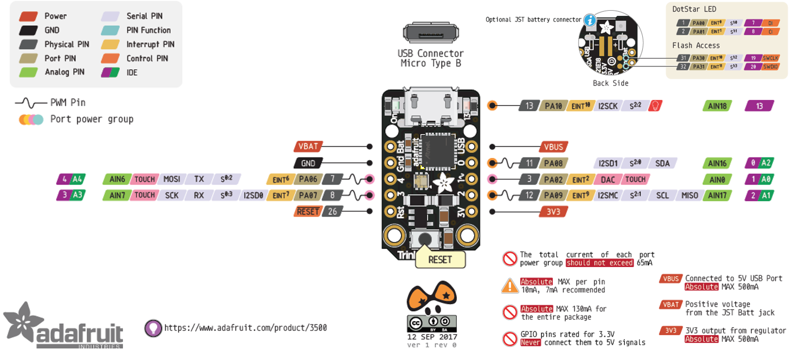
Pinout of the Adafruit Trinket M0
This pinout diagram details which pins have which features.

Slide 19
Working with CircuitPython on the Trinket M0
CircuitPython is based on Python 3. So, most things that work with Python 3 will work with CircuitPython.
CircuitPython libraries are separate files designed to work with CircuitPython code. CircuitPython programs require a lot of information to run. CircuitPython is so simple to use because most of this information is processed in the background and stored in libraries. Some libraries are built into CircuitPython. Others are downloaded and stored on your CIRCUITPY drive in a folder called lib.
CircuitPython looks for a code file on the board to run in the root of the CIRCUITPY drive. There are four options: code.txt, code.py, main.txt and main.py. CircuitPython looks for those files, in that order, and then runs the first one it finds.
Any editor will work to modify the code. Whether you are editing the file directly on the CIRCUITPY drive or copying a code file there, when you save/copy the file it will be immediately run on the board since the board is looking for changes.

Slide 20
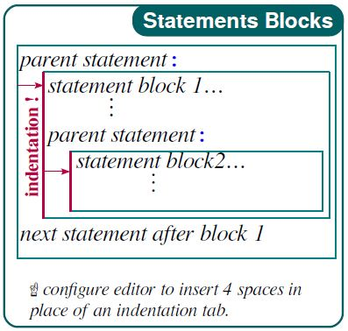
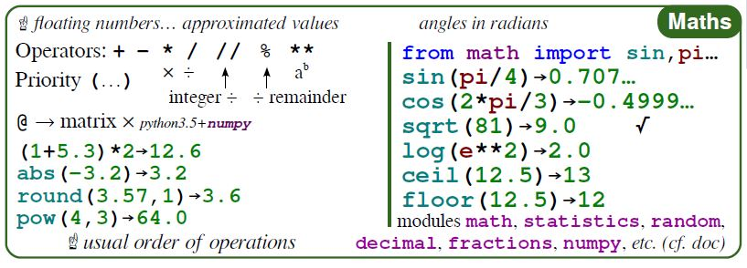
Python Quick Reference

Slide 21
CircuitPython Trinket Projects
This next section will outline some CircuitPython projects using the Trinket M0.
These projects will be centered around two different physical circuit layouts with several CircuitPython code blocks for each.
Adafruit Trinket LED Control – Lab HHV2020_04
Blink the on-board Red LED
Blink both external and on-board LEDs
Fade external LED on/off using PWM
Turn LEDs on/off using a Tactile Switch
Adafruit DotStar RGB LED and Touch Sensor – Lab HHV2020_05
Blink the on-board DotStar RGB LED
Color Cycle the on-board DotStar RGB LED
Use Touch Sensor to Control an external LED
Use Touch Sensor to Color Change the on-board DotStar RGB LED
The Lab reference numbers refer to the BSidesDFW Hardware Hacking Village Videos which can be accessed here: https://altbier.us/bsidesdfwHHV2020/

Slide 22
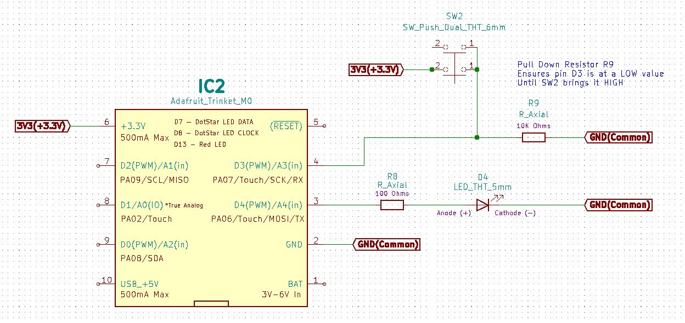
Adafruit Trinket LED Control
LAB HHV2020_04
Schematic

Slide 23
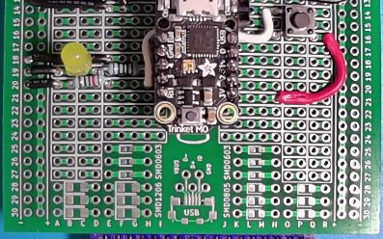
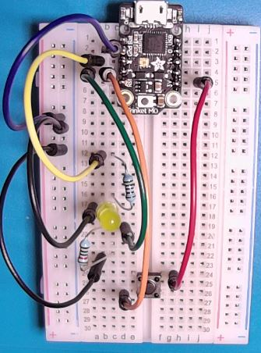
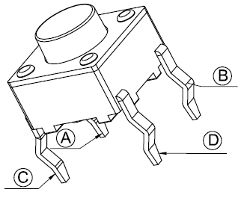
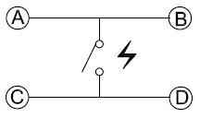
Adafruit Trinket LED Control
LAB HHV2020_04
Physical Layout
Wire up a circuit as shown in the schematic and physical layout.
Strip Board Connection Details
Trinket – I17-21 and J17-21
Resistor 100 Ohm – D19 and H19
LED
Anode – C19
Cathode – B19
Wire – A19 and VCC19
Wire – E18 and VCC18
Switch SPST 4 Pin
Pin A(1) – N14
Pin B(1) – Q14
Pin C(2) – N16
Pin D(2) – Q16
Wire – R16 and N21
Wire – M14 and H20
Resistor 10K Ohm – E20 and B20
Wire – A20 and VCC20
Components:
1x Resistor 100 Ohm
1x Resistor 10K Ohm
1x LED 5mm
1x Tactile Switch SPST 4pin

Slide 24
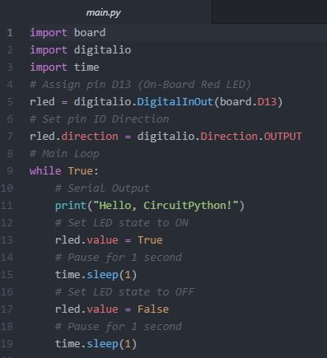
Adafruit Trinket LED Control
LAB HHV2020_04
Blink the on-board Red LED
This simple bit of code will blink the on-board Red LED. This is the same code shown on the ‘Testing Trinket…’ slide.
Let's walk through what it is doing:
Lines 1-3 import the library files we will use. These libraries are built into CircuitPython so they will not be in the lib directory.
Line 5 assigns pin Digital-13 to an object named rled. This is the pin associated with the Red LED.
Line 7 sets the IO pin direction to OUTPUT
Line 9 starts the main While loop that will run indefinitely.
Line 11 prints a string to the serial output. You can see this text output with a serial monitor.
Line 13 sets the value of rled to True which turns ON the LED.
Line 15 pauses the program for 1 second
Line 17 sets the value of rled to False which turns OFF the LED.
Line 19 pauses the program for 1 second
This Code Is Available Here: https://github.com/gowenrw/BSidesDFW_2020_HHV/

Slide 25
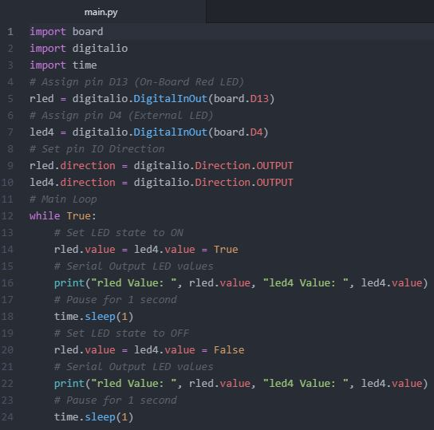
Adafruit Trinket LED Control
LAB HHV2020_04
Blink both external and on-board LEDs
This simple bit of code is like the previous code, adding an external LED. It will blink both the on-board and external LEDs
Let's walk through what it is doing:
Lines 1-3 import the library files we will use.
Line 5 assigns pin D13 (on-board LED) to an object named rled.
Line 7 assigns pin D4 (external LED) to an object named led4.
Line 9-10 sets the IO pin direction to OUTPUT for both pins
Line 12 starts the main While loop that will run indefinitely.
Line 14 sets the value of both LEDs to True which turns them ON.
Line 16 prints strings and values to the serial output.
Line 18 pauses the program for 1 second
Line 20-24 repeats the set/print/pause turning the LEDs OFF.
This Code Is Available Here: https://github.com/gowenrw/BSidesDFW_2020_HHV/

Slide 26
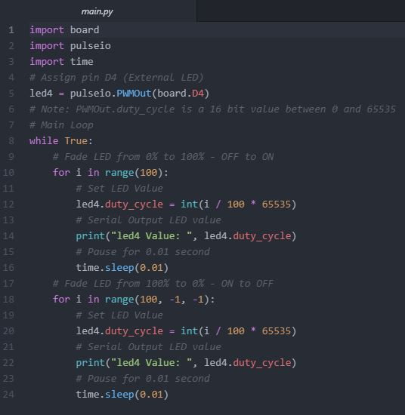
Adafruit Trinket LED Control
LAB HHV2020_04
Fade external LED on/off using PWM
In the previous code we defined a digital output pin for our LED.
In this code we define a PWM (Pulse Width Modulation) output pin which mimics analog allowing the LED to be in between ON or OFF.
Let's walk through what's different:
We import the pulseio instead of the digitalio library.
We assign the led4 object to a PWMOut which is output only so we don’t set a direction.
We use for loops with a range of 100. The first loop iterates up to fade the LED ON, the second iterates down to fade it OFF.
Instead of setting a value of True(HIGH) or False(LOW) we are setting the duty_cycle which represents the percentage of time the pin will be in the HIGH state. The duty_cycle is a 16-bit number (0 to 65535).
This Code Is Available Here: https://github.com/gowenrw/BSidesDFW_2020_HHV/

Slide 27
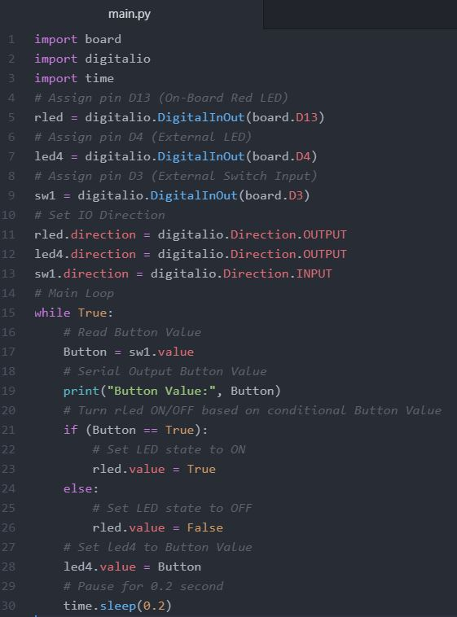
Adafruit Trinket LED Control
LAB HHV2020_04
Turn LEDs on/off using a Tactile Switch
This code will read the state of a tactile switch (button) and use that to control the LEDs turning them on when pressed.
We will use the button value in two ways, as a conditional check and as a raw value to send to an object (an LED).
Let’s look at the key items in this code:
Assign rled and led4 pins as digital output
Assign sw1 pin as digital input
Read in the sw1 value and print it to serial
Use an if conditional statement to check if sw1 is True and set rled to True (LED ON) if it is, else set it to False (LED OFF)
Set led4 to be equal to sw1 value (True or False, ON or OFF)
This Code Is Available Here: https://github.com/gowenrw/BSidesDFW_2020_HHV/

Slide 28
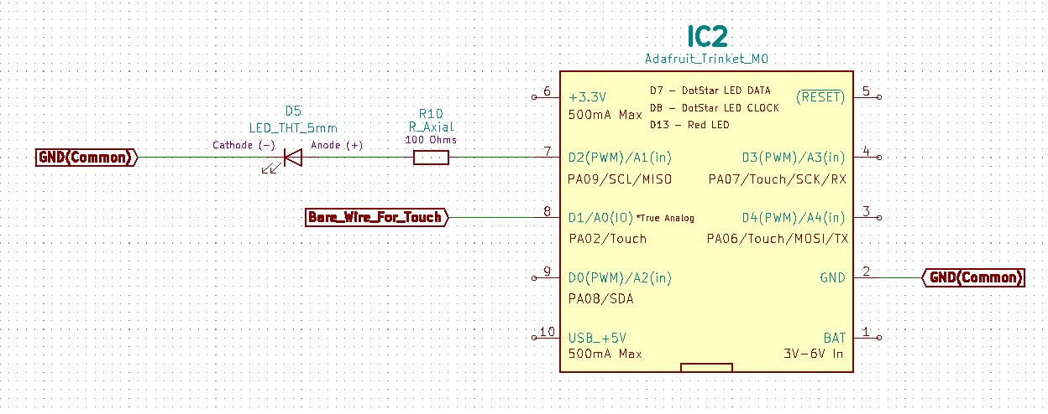
Adafruit DotStar RGB LED and Touch Sensor
LAB HHV2020_05
Schematic

Slide 29
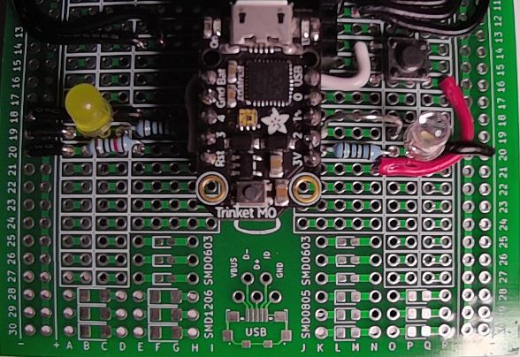
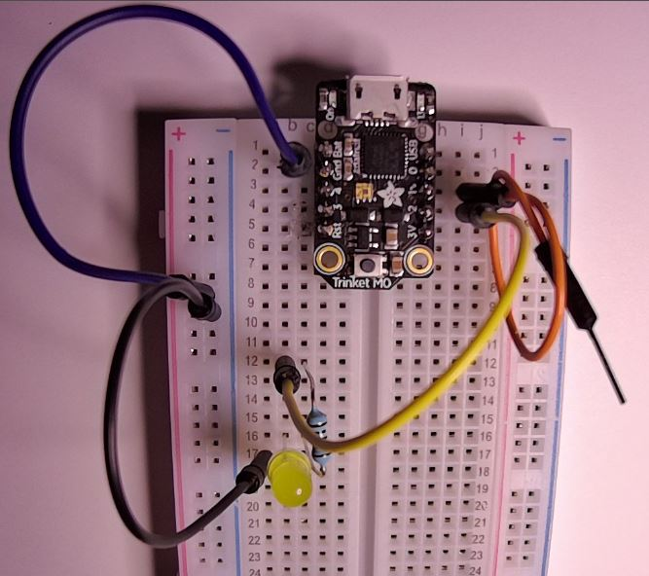
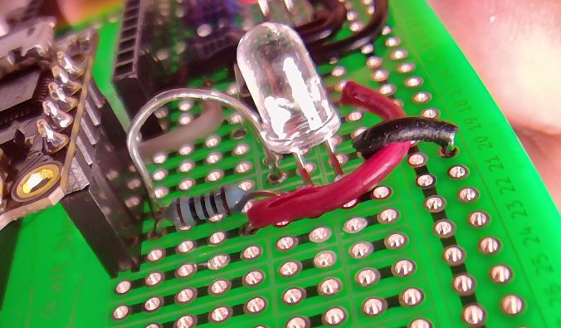
Adafruit DotStar RGB LED and Touch Sensor
LAB HHV2020_05
Physical Layout
Wire up a circuit as shown in the schematic and physical layout.
Strip Board Connection Details
Trinket – I17-21 and J17-21
Resistor 100 Ohm – K20 and O20
LED
Anode – P20
Cathode – Q20
Wire – R20 and VCC20
Bare Wire – K19 and O19
Components:
1x Resistor 100 Ohm
1x LED 5mm
1x Bare Wire (for touch)

Slide 30
CircuitPython Library Files Needed
LAB HHV2020_05
Adafruit DotStar RGB LED and Touch Sensor
The code used in the following examples will require some library files that are not built into CircuitPython.
You can find the library file bundle packages for recent versions of CircuitPython here: https://circuitpython.org/libraries
Download the bundle for the version you are working with (5.x) and extract it in a directory on your PC.
Locate these two library files on your PC and copy them to the lib directory on the CIRCUITPY drive:
adafruit_dotstar.mpy
adafruit_pypixelbuf.mpy

Slide 31
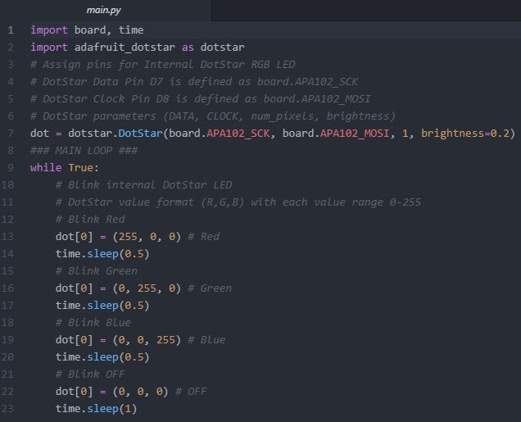
Adafruit DotStar RGB LED and Touch Sensor
LAB HHV2020_05
Blink the on-board DotStar RGB LED
This code will blink the on-board DotStar RGB LED. This uses some library files not included in CircuitPython.
Let’s look at the key items in this code:
Import adafruit_dotstar library
It calls the library adafruit_pypixelbuf
Assign dot object data pin APA102_SCK, clock pin APA102_MOSI, pixel_num=1, and brightness=0.2
Note: The board lib defines pins D7 & D8 as different names
Set the Value of dot[0] to Red, Green, Blue, then OFF using a value list formatted (R,G,B) with values 0-255
Pause briefly between color changes.
This Code Is Available Here: https://github.com/gowenrw/BSidesDFW_2020_HHV/

Slide 32
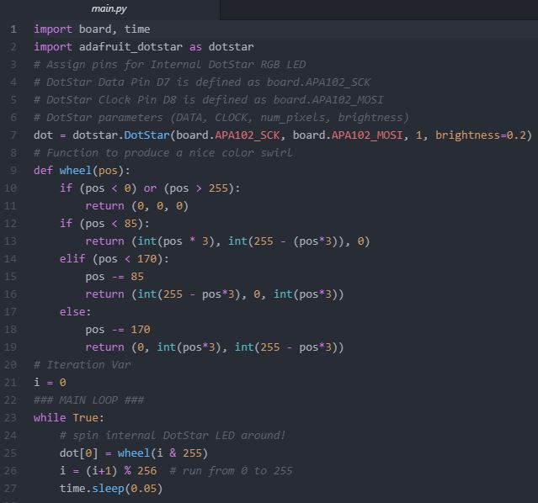
Adafruit DotStar RGB LED and Touch Sensor
LAB HHV2020_05
Color Cycle the on-board DotStar RGB LED
This code will Color Cycle the on-board DotStar RGB LED.
Let’s look at the key items in this code:
Import adafruit_dotstar library
Assign dot object data pin APA102_SCK, clock pin APA102_MOSI, pixel_num=1, and brightness=0.2
Define a function wheel(pos) that will take an integer and return a list formatted (R,G,B) with values 0-255
Set dot[0] to the value that wheel(i) returns
Increment the var i keeping it between 0-255
Pause briefly between color changes.
This Code Is Available Here: https://github.com/gowenrw/BSidesDFW_2020_HHV/

Slide 33
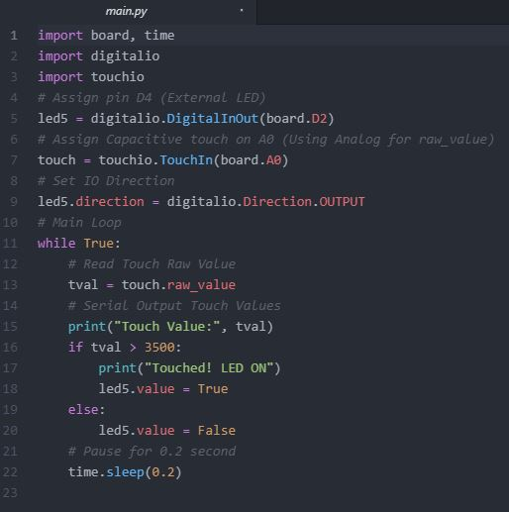
Adafruit DotStar RGB LED and Touch Sensor
LAB HHV2020_05
Use Touch Sensor to Control an external LED
This code will use a Capacitive Touch Sensor to control and external LED turning it on when touched.
Let’s look at the key items in this code:
Import touchio library
Assign touch object to TouchIn analog pin A0
Read the value of touch
Use an if conditional statement to test for a touch.
Given that the touch pin is analog it will register values all the time and we must set our test value higher than ambient values
If a touch is registered set led5 to True turning it ON
Pause very briefly between loops.
This Code Is Available Here: https://github.com/gowenrw/BSidesDFW_2020_HHV/

Slide 34
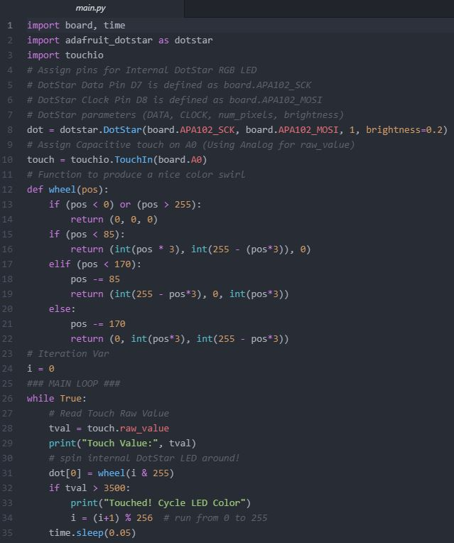
Adafruit DotStar RGB LED and Touch Sensor
LAB HHV2020_05
Use Touch Sensor to Color Change the DotStar RGB LED
This is the same code we used earlier to Color Cycle the DotStar RGB LED with a slight modification to add touch.
The color will now only cycle when touched staying steady at its current color when not touched.
Let’s look at the key items added to the existing code:
Added the touchio library import
Assign touch object to TouchIn analog pin A0
Read the value of touch
Use an if conditional statement to test for a touch and increment the iteration variable i only if touched
Pause very briefly between loops.
This Code Is Available Here: https://github.com/gowenrw/BSidesDFW_2020_HHV/

Slide 35
Thank You
I hope you enjoyed this presentation and learned something from it.
-- @alt_bier
This Slide Deck – https://altbier.us/circuitpython/
Code – https://github.com/gowenrw/BSidesDFW_2020_HHV/

